Slide 1
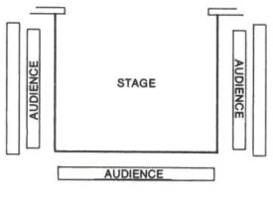
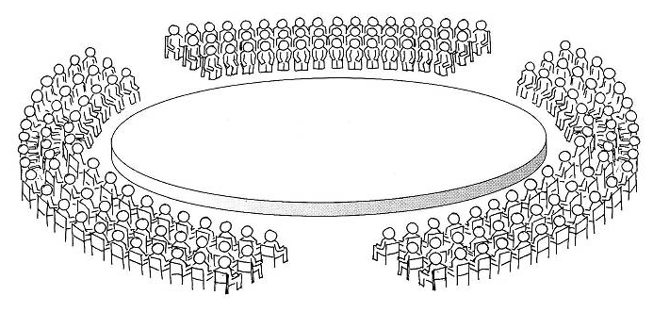
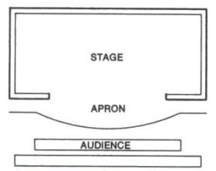
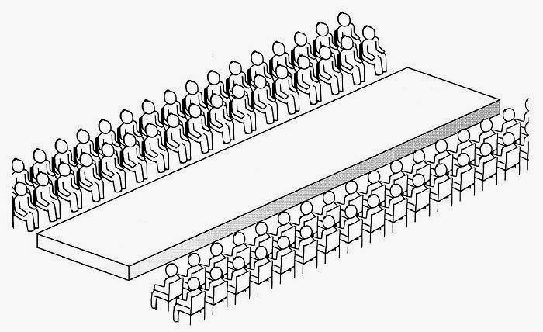

Slide 2
Thrust staging
In the Round
End On
Traverse Staging

Slide 3
TYPES OF STAGING
End on
‘As if looking through a window’
It is easier for an actor to block out the audience
In the round
Staging can’t obscure the audience’s view
Careful attention to movement is required (backs to the audience!!)
Traverse
Staging can’t obscure the audience’s view
Actors should not keep their back to the same section of the audience for too long
Thrust stage
No curtains separate the audience from the stage
Difficult to change sets during a performance

