Slide 1


Playwright
What roles and responsibilities might a playwright have?
This is the name given to the person who writes the play.
Can you think of any famous examples?
Notes:
William Shakespeare, Samuel Beckett, Arthur Miller, Tennesse Williams, Oscar Wilde – Modern day playwrights Willy Russel (Our Day Out, Blood Brothers), Caryl Churchill (Top Girls),

Slide 2

Performer
What roles and responsibilities might a performer have?
A performer is an actor or entertainer who realises a role of performance in front of an audience.
Can you think of any famous examples?

Slide 3
Understudy
What roles and responsibilities might an understudy have?
An actor who studies another’s role so that they can take over when needed.
When might you need an understudy?

Slide 4

Light designer
What roles and responsibilities might a light designer have?
They are responsible for designing the lighting states and, if required, special lighting effects for a performance.
The final design will have a lighting plot, a list of the lighting states and their cues.

Slide 5
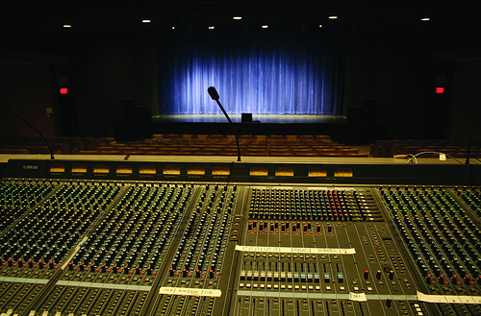
Sound designer
What roles and responsibilities might a sound designer have?
They are responsible for designing the sound required for a performance.
This may be underscoring, intro and outro music as well as specific effects.
The final design will have a sound plot, a list of the sounds required and their cues.

Slide 6
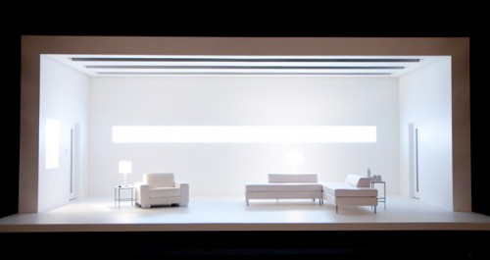
Set designer
What roles and responsibilities might a set designer have?
They are responsible for the design of the set for a performance.
They will work closely with the director and other designers so that there is unity between all the designs and the needs of the performance.

Slide 7
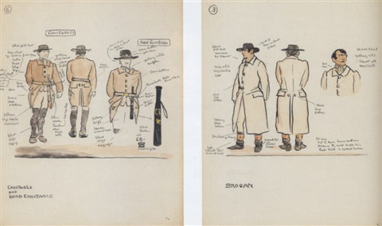
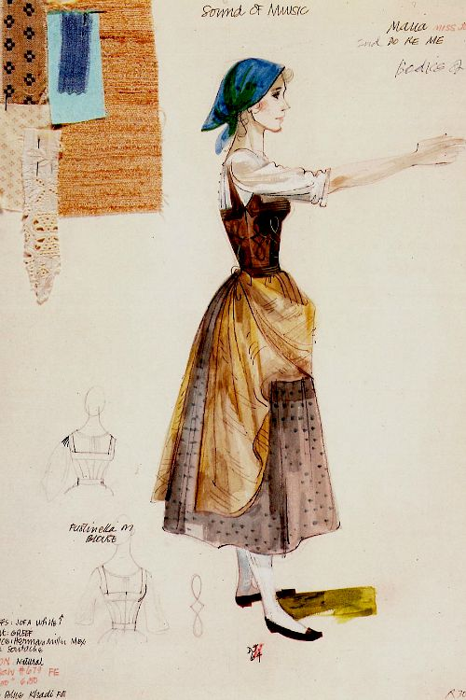
Costume designer
What roles and responsibilities might a costume designer have?
They are responsible for the design of the costume for a performance.
The costume department of a theatre is often called the wardrobe.
There is also a role called a ‘puppet designer’

Slide 8
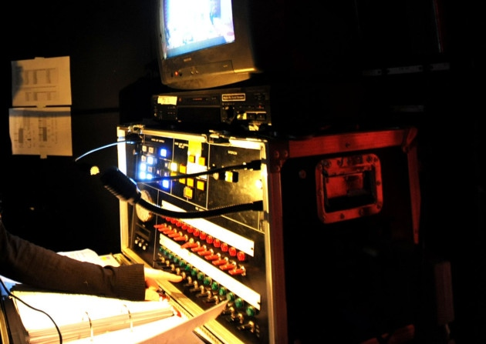
Technician
What roles and responsibilities might a technician have?
They work backstage either setting up technical equipment.
For example, they might be responsible for microphones or rigging lights before a production or operating technical equipment during a performance.

Slide 9
Director
What roles and responsibilities might a director have?
A director is in charge of the artistic elements of the production.
A director will often have the initial creative idea (‘concept’) for a production.
They will work with the actors in rehearsal, collaborate with designers and the technical team to realise their ‘concept’ in performance.

Slide 10
Stage manager
What roles and responsibilities might a stage manager have?
They are in charge of all aspects of backstage, including the backstage crew.
They oversee everything that happens backstage, before, during and after a performance.
Stage manager and their team ensure all props are found or made, scene changes are rehearsed and smooth, and in charge of the rehearsal schedule.

Slide 11
Theatre manager
What roles and responsibilities might a theatre manager have?
This is the person who is responsible for and managed the front-of house team.
A front-of house team deal with the audience during the performance, for example the box office manager, ushers and similar staff.

