Slide 1

The Reading Log
Years 7 - 9

Slide 2
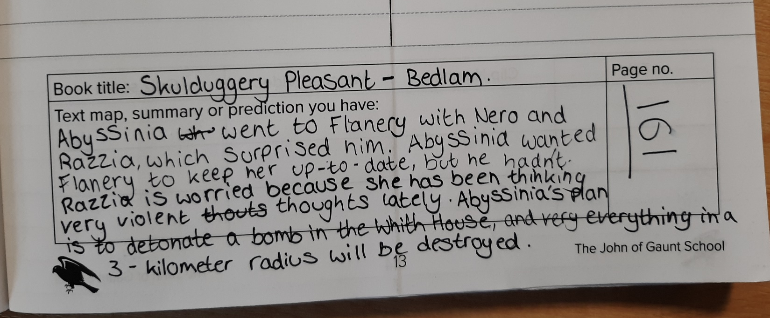
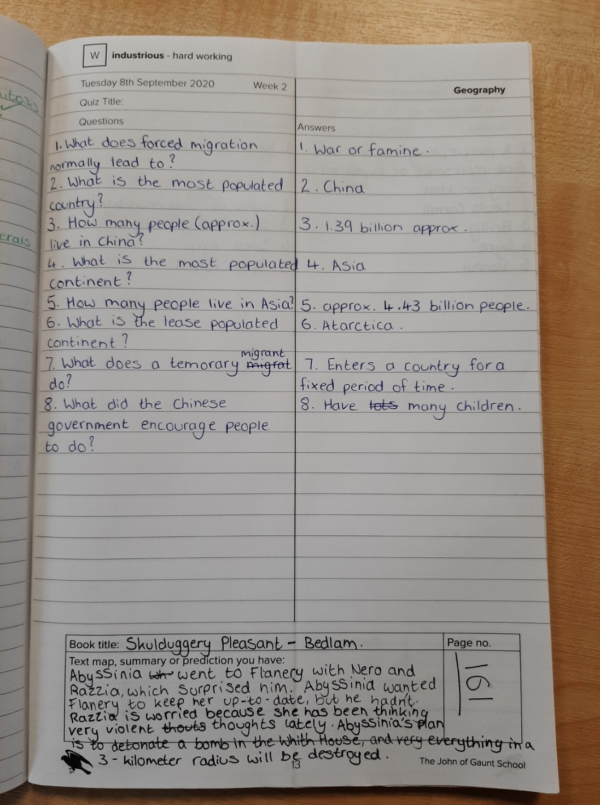
The reading log should be completed every week day.
Above is an example of a student summarizing what was read.
Students in years 7 & 8 will have further guidance and support with their reading log during their library lessons.

