Slide 1




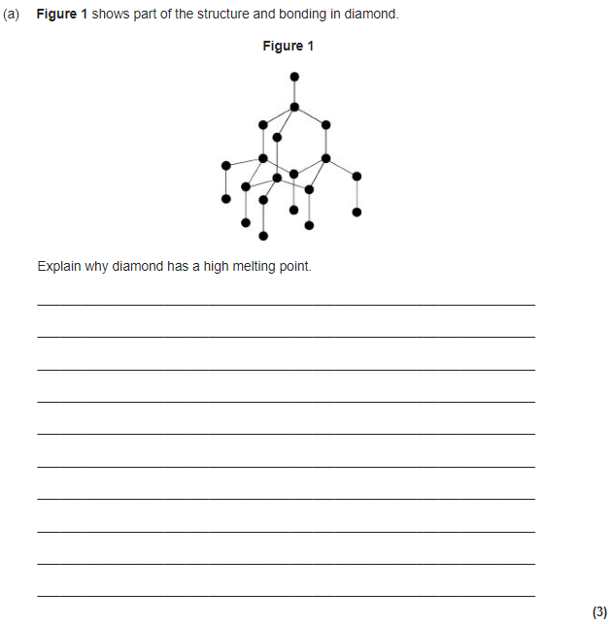
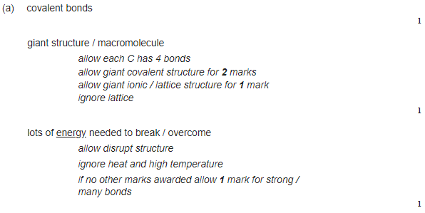

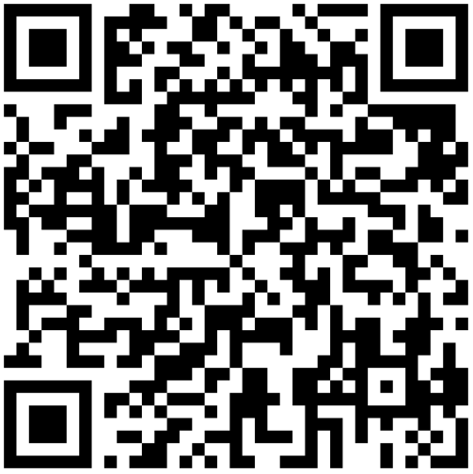

GCSE CHEMISTRY
Paper 1 – C2 – Structures of Carbon
FOLD OVER TO TEST YOURSELF →→→→
Key Vocabulary | Definition
Fullerenes | carbon molecule, spherical, cylindrical, etc., e.g. Buckminster or Bucky ball
Graphene | allotrope of carbon, semi-metal, good conductor, single layer of carbon atoms in hexagonal structure
Graphite | allotrope of carbon, semi-metal, good conductor, natural mineral, soft but stable
Diamond | carbon giant covalent structure, uniform diamond cubic structure, very hard
Task | Link to resource | QR Code
Watch the videos | https://www.youtube.com/watch?v=6jCJXhusI2M
Learn knowledge and practice questions | https://www.bbc.co.uk/bitesize/guides/z9twsrd/revision/2
Practice exam questions | https://www.bbc.co.uk/bitesize/guides/z9twsrd/test

