Slide 1

Welcome
Year 6 Parents’ Information Evening

Slide 2
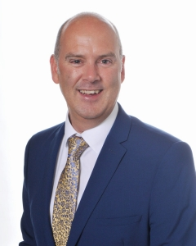
Welcome Mr Woodville

Slide 3
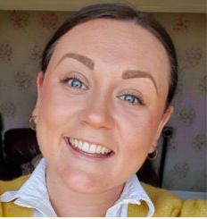
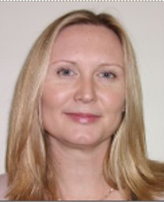
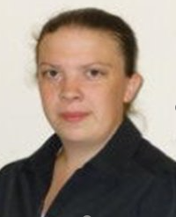
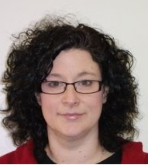
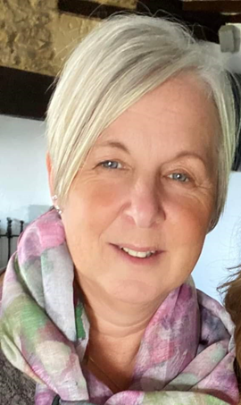
Key Staff
Miss Z Lewis
Head of Year 7
Ms S Stewart
Year 7 Pastoral Lead
Mrs V Marshall
SENDCo
Mr M Woodville
Headteacher
Mrs H Kerr
Assistant Headteacher
Inclusion & Safeguarding
Mrs S Hill
Pastoral Manager

Slide 4
Meet Your Tutors
7A Mr Smith
7B Miss Diaper
7C Mr Bilsdon
7D Miss Farthing
7E Miss McPherson
7F Ms Knee
7G Mrs Gear
7H Mr Stallworthy
7I Mrs Murtagh

Slide 5
Friday 2 September – Year 7 only in school
Be on school site by 8.30 am ​and head to Sports Hall (say goodbye to parents at the gate or in the car)
The day will be spent with the tutor doing lots of activities to get to know the school and each other
Lunch will be provided for you for free
Please bring with you:
School bag
Pencil case
Biometric and any other forms that have not been handed in
YEAR 7 ONLY!

Slide 6
Monday 5th September
Be on school site by 8.30 am ​and head to Sports Hall (say goodbye to parents at the gate or in the car)
Please bring with you:
School bag
Pencil case
Biometric and any other forms that have not been handed in

Slide 7




Equipment
For art, if possible:​
Glue stick​
Set of 12+ colouring pencils​
Set of 12+ felt tip colouring pens​
Sharpener​
Rubber​
Rounded safety scissors​
A HB and a 2B drawing pencil
Every day essentials​
Blue or black pen​
Green pen​
highlighter​
Pencil​
Ruler​
Reading book​
Knowledge organiser​
Homework book​
Headphones
Subject specific​
​Maths
calculator, protractor, pair of compasses
when timetabled ​
PE kit​
Food ingredients​

Slide 8
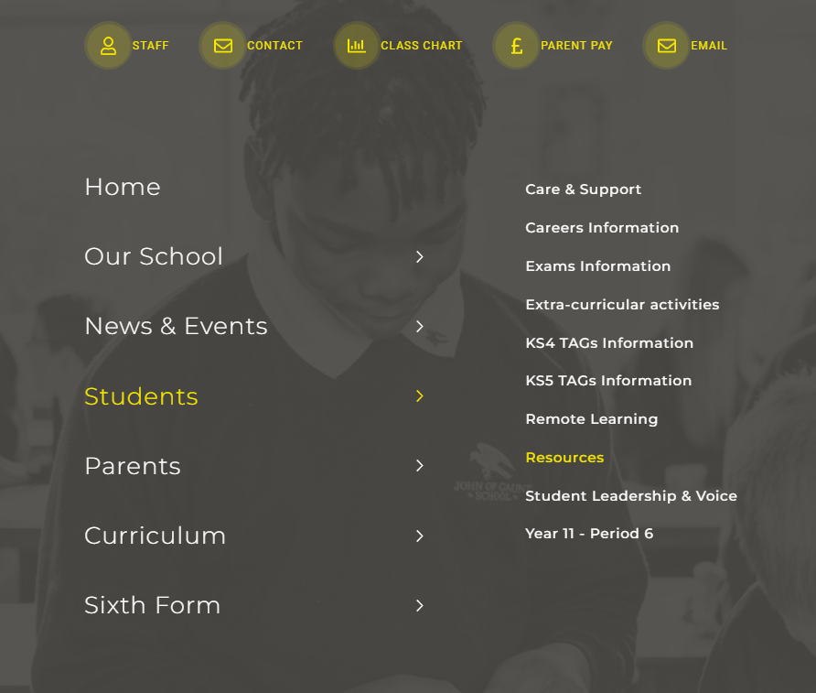
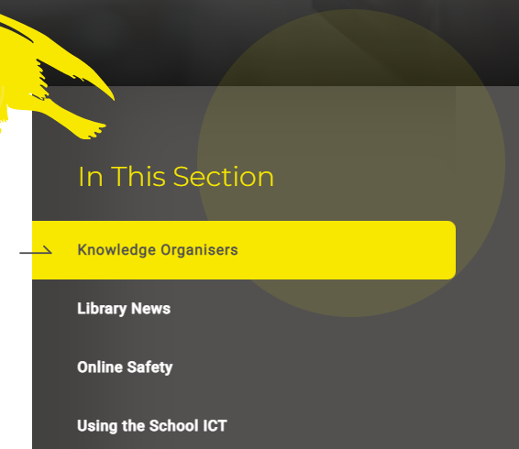
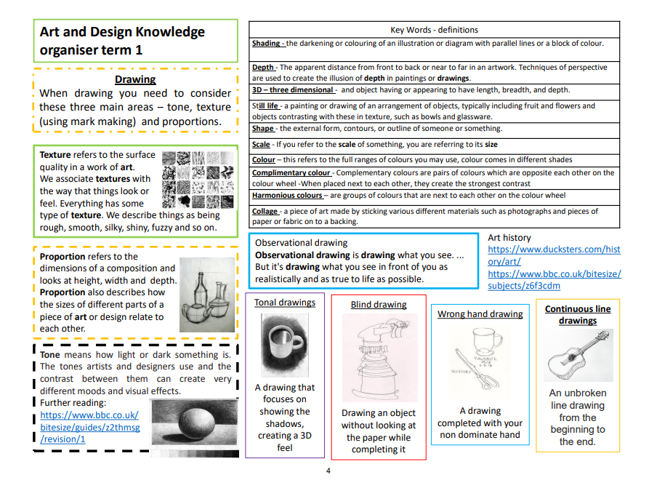
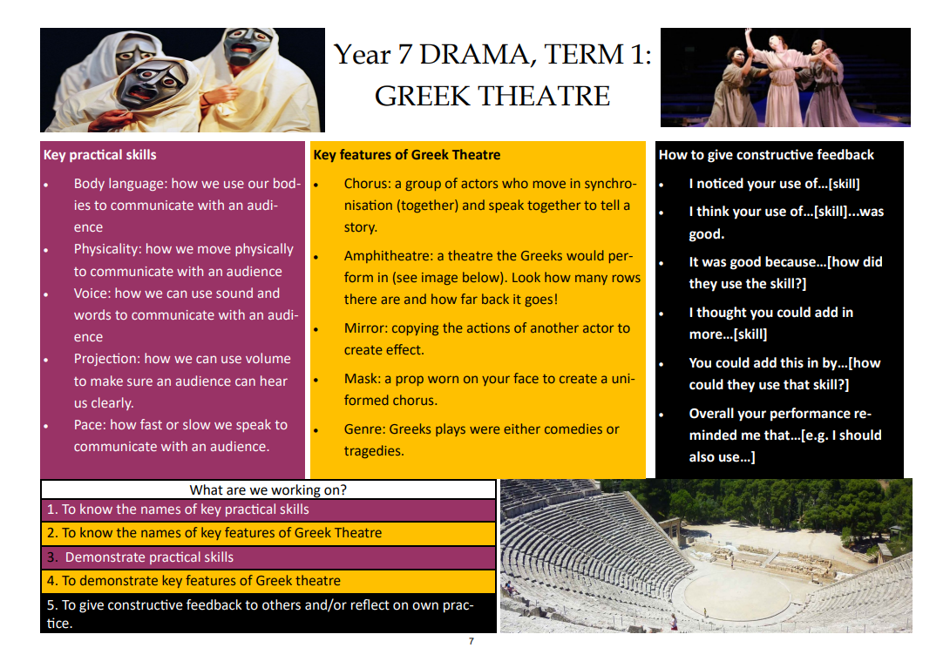
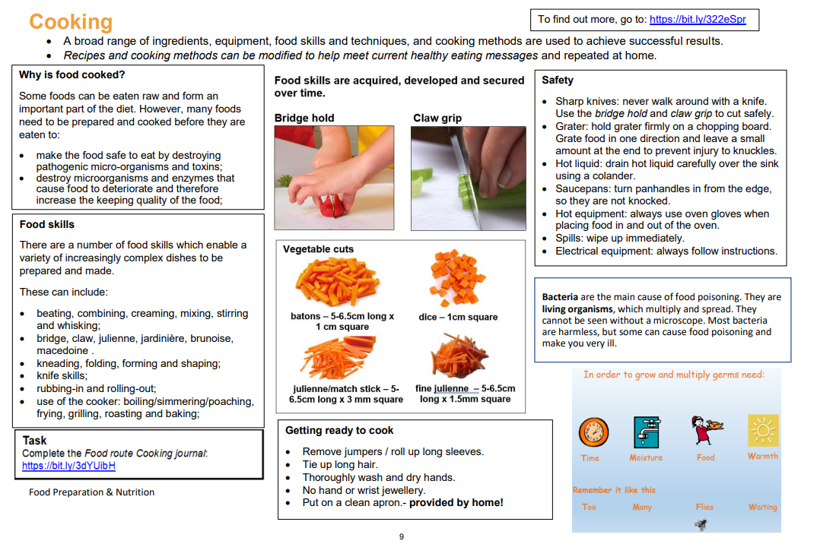
Knowledge Organisers

Slide 9
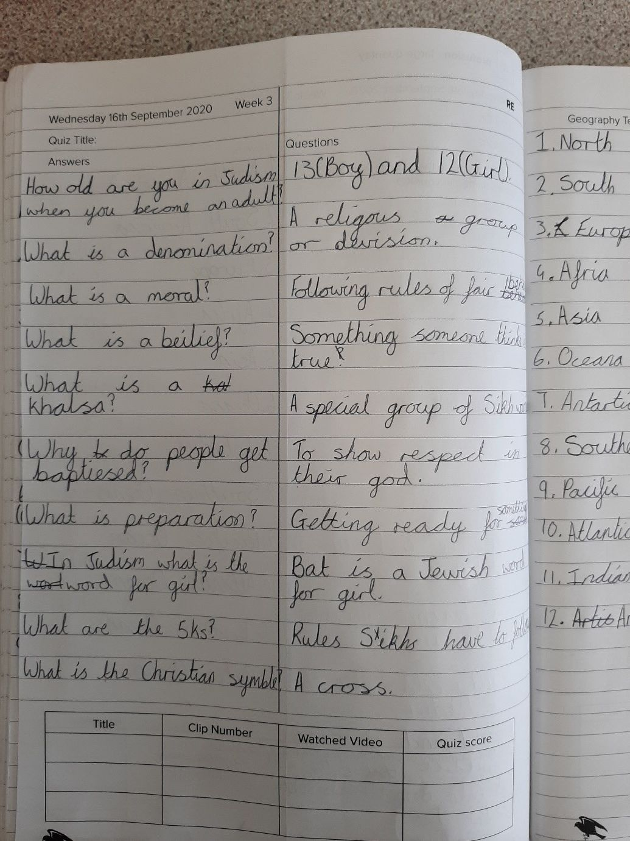
THE POWER HOUR
KS3 – Years 7 - 9:​
up to 1 hour of additional study each week day ​in their planner using the KO
Two subjects self-quizzed from the knowledge organiser ​
Literacy - Independent reading ​(log pages & summary of what has happened)
Maths - Hegarty Maths ​(log clip number)
There may also be the occasion where, for example, there is a hot task that requires additional learning to happen prior to the task.​

Slide 10
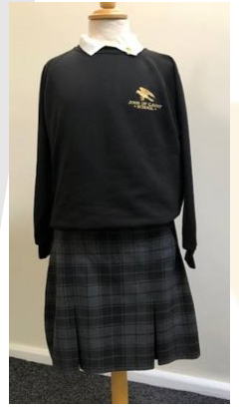
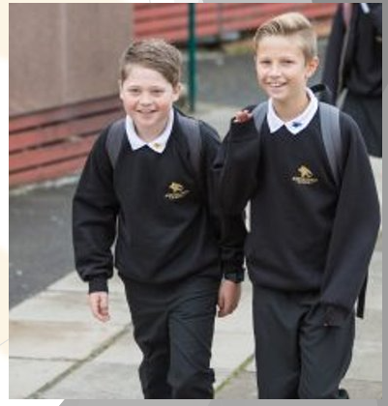
Uniform
Official school skirt or black tailored trousers
Logo polo and sweatshirt
Polishable plain black shoes
No Makeup
Plain dark coat
Suitable bag, preferably a rucksack type
Jewellery:​
Watch​
One ring​
One pair of stud earrings

Slide 11
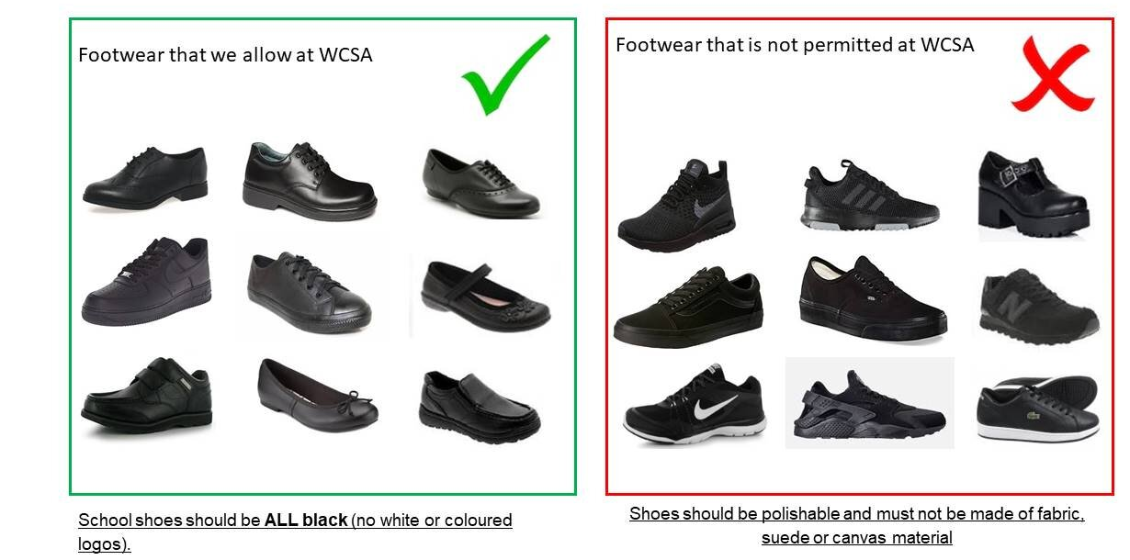
Footwear Expectations

Slide 12
Second Hand Shop
We have a stock of the items listed below.
Please contact Mrs Lee on reception between 9.30am and 2.30pm to arrange viewing/collection​
Jumper £4​
Polo Shirt £2​
We are also able to support with payment of uniform on an individual basis

Slide 13

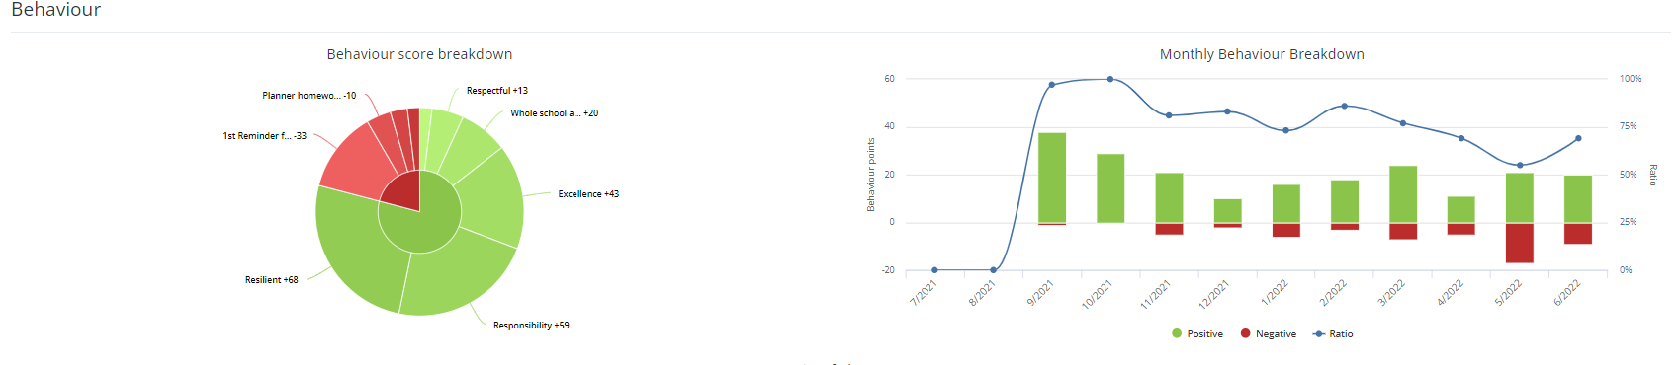
Each Student has a unique code assigned to them, the adults responsible for the code may share this code to create their own login so parents can both view the information on Class Charts​
Students have a unique login provided for the student app.​
DISRUPTION FREE LEARNING

Slide 14

Class Charts Access
Download from Play store / Apple App Store​
One app for parents​
One app for students​
Can be accessed for Computers, phones and tablets via the app or the class charts website
Used to monitor behaviour​
Reward store​
Announcements to students and parents​
Communicate with parents​
Timetable​
To view set homework (Homework may also be uploaded to teachers via class charts)​

Slide 15

Rewards
On the student app, students can see how many rewards they have accumulated and choose to buy items or save up for bigger and better rewards.​
We never take reward points away​

Slide 16







Device Free Zone
As soon as students enter the gates until 5pm

Slide 17

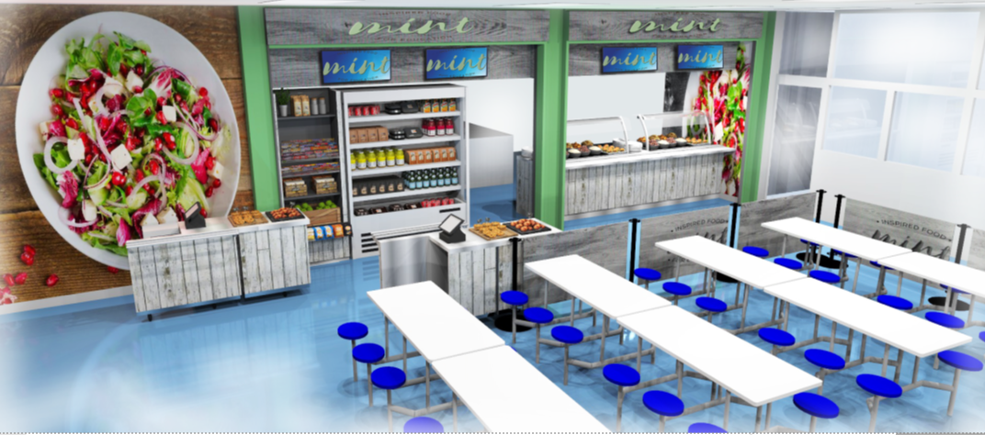
Canteen
Cashless System
Fingerprint
Please return biometric form so we can set up an account using thumbprint​
Those without thumbprint scanned will be issued with a PIN instead​
Accounts can be topped up online or using the cash loader in school.
Default limit of £5 spend per day but you can change this.​

Slide 18







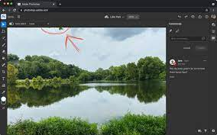
Extra-Curricular

Slide 19
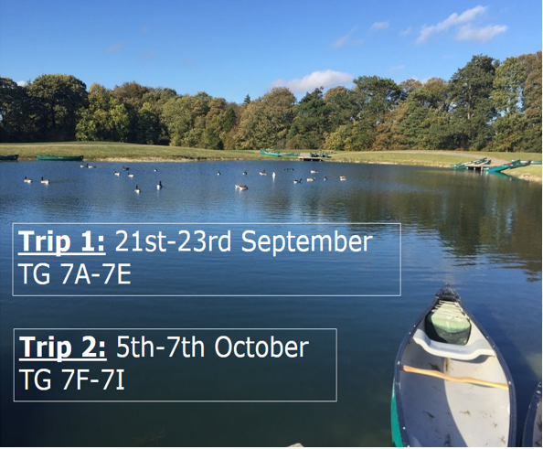
PGL 2022
Total cost £99​

Slide 20
Supporting Your Child with Transition
Create routines (AM & PM)
Rewards
Resilience
Seek support when needed
Encourage to communicate feelings

Slide 21

Social media​
Remember you are responsible for what your child views and posts on line!​
Check regularly and talk about the harm and well as the benefits

Slide 22
Key Dates for Term 1 & 2
Friday 2nd September – Year 7 Only
Wednesday 7th September – School Photos
Wednesday 21st Sept – Friday 23rd Sept – PGL 1
Wednesday 5th Oct – Friday 7th Oct – PGL 2
Monday 17th October – Year 7 Tutor Evening
Tuesday 1st November – First Day Back for Term 2

Slide 23
Communications
SchoolGateway
Class Charts – live notifications
Subject specific queries?
Email the subject teacher or Department Leader
Non-subject related specific queries? Email the tutor
aname@jogschool.org
Very happy to meet face-to-face, but do call ahead first as appointments are needed.

